Slide 1
Airbnb in New York: A Python/R Analysis
Created by:
Rounak Nischal Danielle Rowan
Aakash Bhargava Dhruval Patel
Notes:
#FF585D

Slide 2
Introduction
Founded: 2008 in San Francisco Founders: Brian Chesky, Joe Gebbia and Nathan Blecharczyk Mission Statement: Airbnb's mission is to help create a world where you can belong anywhere and where people can live in a place, instead of just traveling to it.
Currently:
Operations in 220+ countries
7 M+ listings Worldwide
Average of 2M+ people staying in an Airbnb each night
Gives customers an opportunity to find an apartment, room, house and now even experiences

Slide 3
Questions
How is price impacted by location and physical attributes? What impact does price have on review scores?
Why are there more airbnbs in certain locations?
Could ease of transportation or landmarks be a reason?
What are the key predictors of price? can we get an approximate price range for each neighborhood, room type, and other predictors?
What kind of model can we create with this information to use as a prediction for future analytics? What sort of predictions can we make for those hosts?
Danielle
Rounak
Dhruval
Aakash

Slide 4
How is price impacted by location and physical attributes?
What impact does price have on review scores?
—Danielle

Slide 5
Data wrangling For Physical Attributes
Drop columns of no interest in our scope of interest
Adjust for missing data and standardize format
Drop outliers
Focus in on variables for a “typical” Airbnb host
Bathrooms: 0-4, Bedrooms: 0-6, Beds:0-9
Guests Included 0-10, Accommodates:0-16
Original data set: 50,796 rows + 106 columns
After cleaning: 49,063 rows + 18 columns

Slide 6
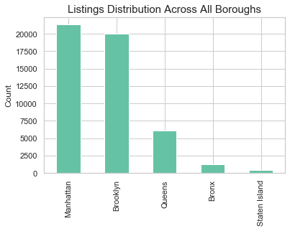
Summary ACross all of New York CiTy Listings
Listings:
49,603 total listings
Manhattan: 21,354
Brooklyn: 19,973
Queens: 6,139
Bronx: 1,228
Staten Island: 369

Slide 7
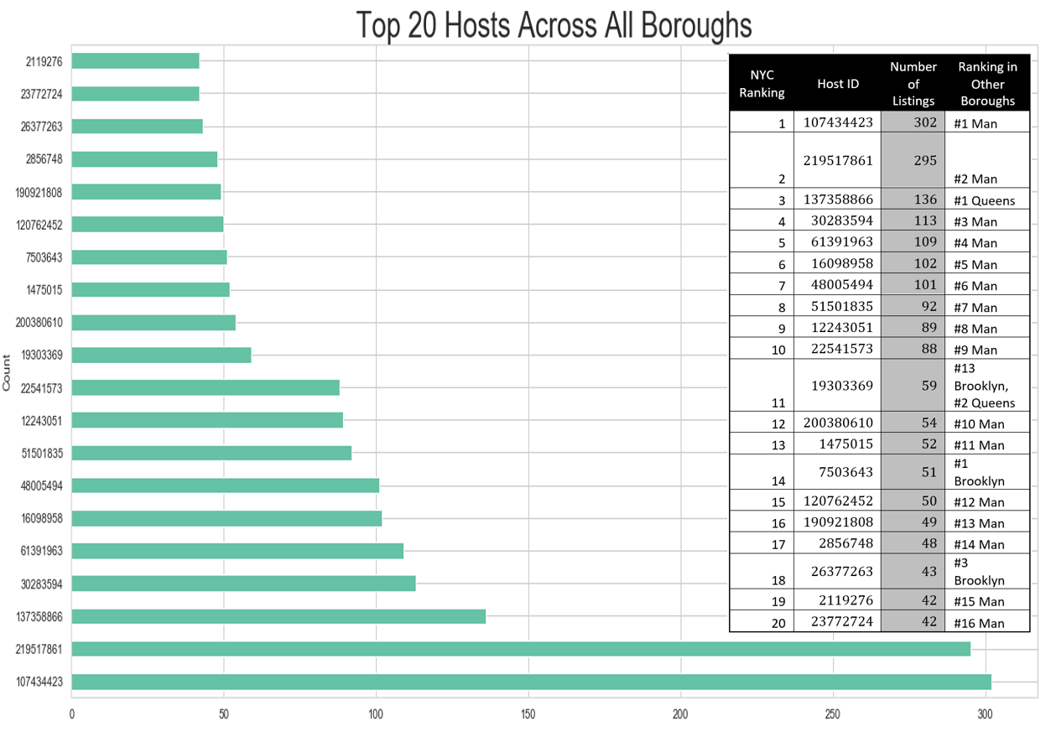
Summary ACross all of New York CiTy Listings
Hosts:
36,877 total in NYC
Top 20 shown is figure:
the majority of these top 20 are also the top hosts by count in Manhattan
Host 7503642: #14 in NYC, #1 in Brooklyn
Host 19303369 has 59 listings total with 15 in Brooklyn (#13) and 37 in Queens (#2)

Slide 8
Summary ACross all of New York CiTy Listings
Average price per night: $130.58, maximum: $500.00, minimum : $0.00
75% of listings are priced between $67.00 & $170.00

Slide 9
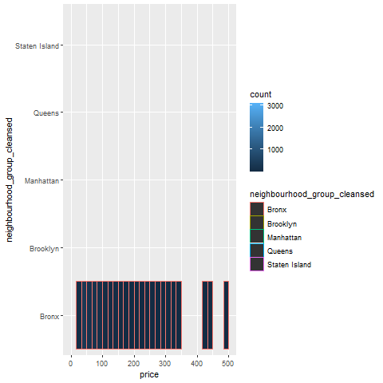
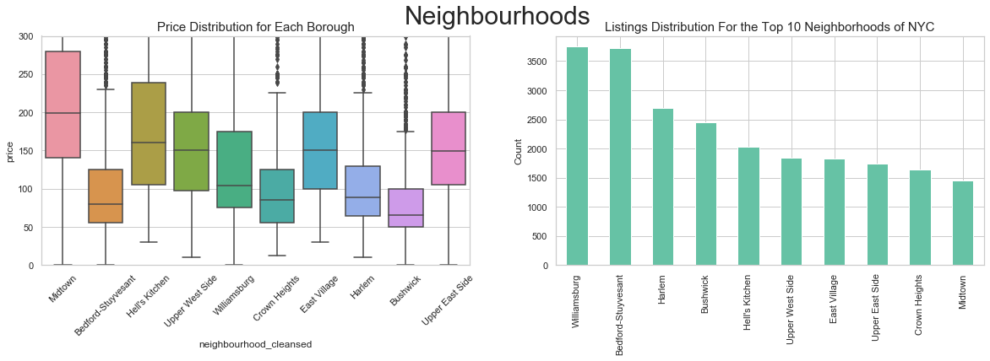
Summary ACross all of New York CiTy Listings
Neighborhoods
Top 10 Neighborhoods in all of NYC:
Midtown highest prices, lowest number of listings in top 10
Bedford-Stuyvesant is nearly tied for top list count and is almost tied for lowest prices

Slide 10
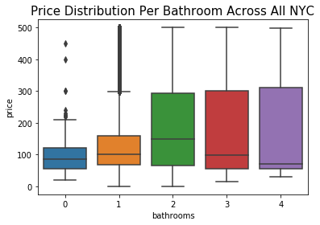
Physical Attributes: Bathrooms
Bathrooms
Average: ~1
From 0-2 bathrooms per listing = positive relationship with price
From 2-4 bathrooms per listing = price distribution remains consistent
Manhattan and Brooklyn follow this same trend, other boroughs vary

Slide 11
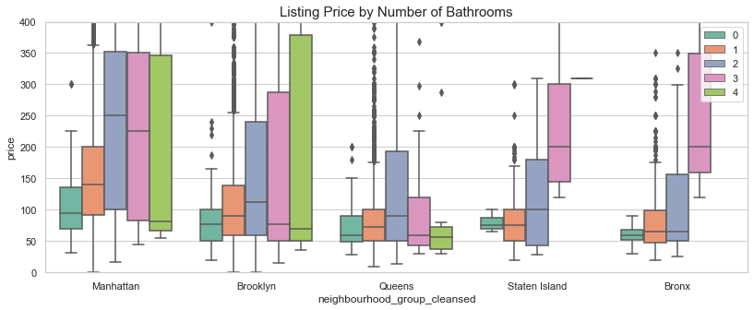
Physical Attributes: Bathrooms

Slide 12
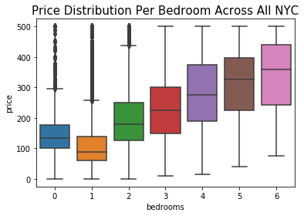
Physical Attributes: Bedrooms
Bedrooms
Average: ~1
Positive relationship between number of bedrooms and price , with exception of 0 bedroom listings
Trend is seen is all boroughs, although the Bronx is slightly different

Slide 13
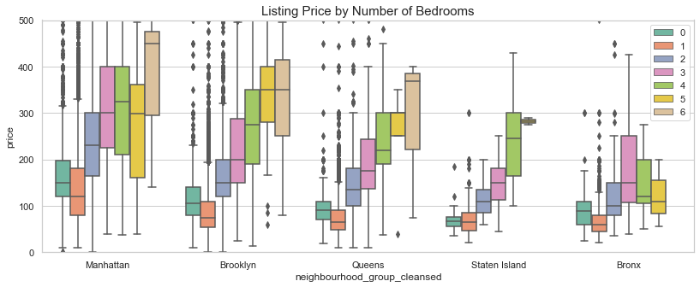
Physical Attributes: Bedrooms

Slide 14
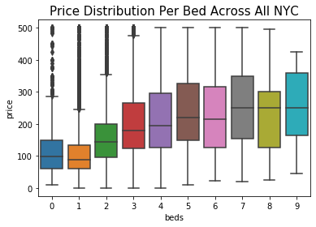
Physical Attributes: Beds
Beds
Average~1
Positive relationship between number of bedrooms and price , with exception of 0 bedroom listings
Trend is seen is all boroughs,

Slide 15
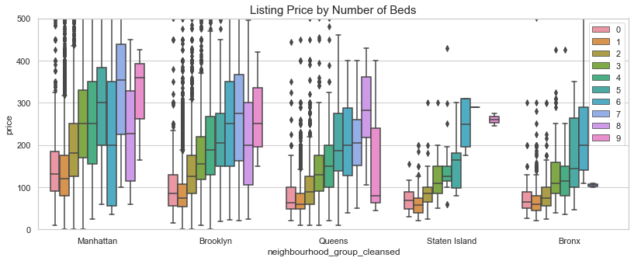
Physical Attributes: Beds

Slide 16
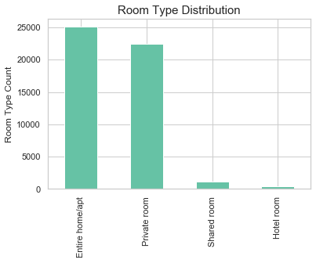
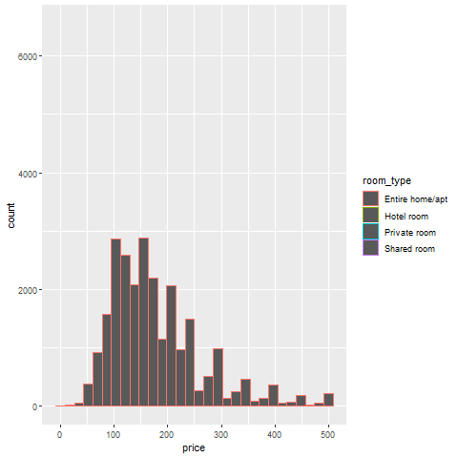
Physical Attributes:Room Type
Room Type:
private room
entire home/ apartment
shared room
hotel room
The large majority of listings across NYC are entire home/apts and private rooms
This varies across each borough as seen in borough profiles

Slide 17
Physical Attributes:Room Type
Hotel rooms have largest price range, only available in Manhattan, Brooklyn, & Queens
Shared rooms have the lowest prices, private rooms are fairly close to shared room prices ranges

Slide 18
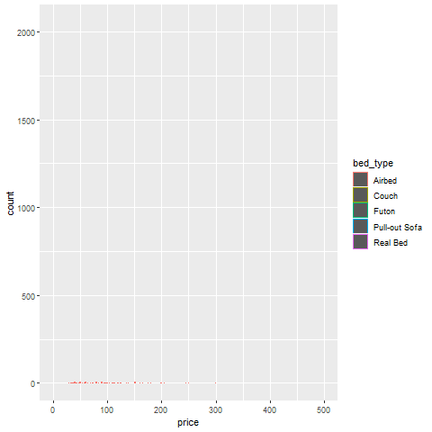
Physical Attributes:Bed Type
Pull out sofa
Airbed
Couch
Almost all listings provide real beds
Bed Type:
Real bed
Futon

Slide 19
Physical Attributes:Bed Type
Real beds have higher ranges of prices, with the exception of Staten Island where listings with pull-out sofas have higher minimum price range than other bed types
As would be expected, Manhattan and Brooklyn typically have higher prices across all bed types

Slide 20
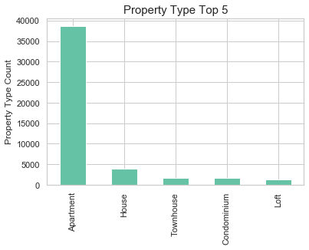
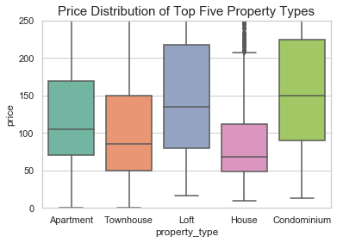
Physical Attributes:Property Type
Property Type: 25 types, focusing on top 5 for all NYC: apartment, house, townhouse, condo, and loft.
Majority of listings are apartments
Condos and lofts have larger price ranges as well as higher price ranges

Slide 21
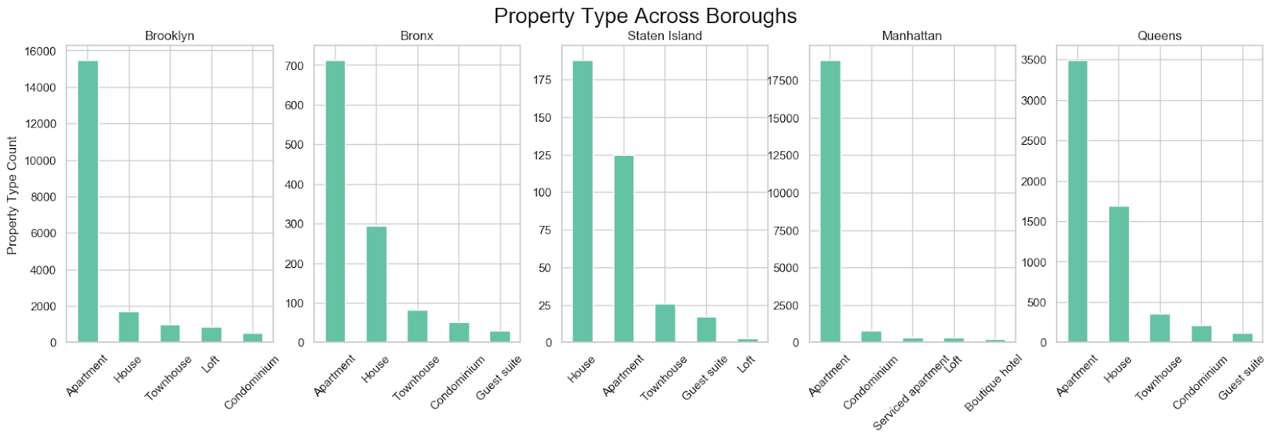
Physical Attributes:Property Type
Within each borough different property types are most popular
Staten Island: most popular property type is house

Slide 22
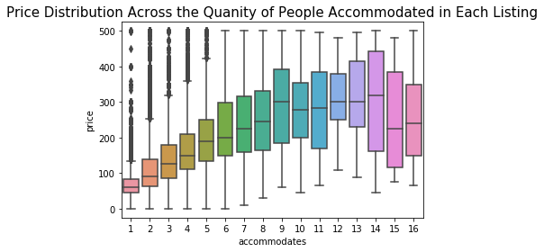
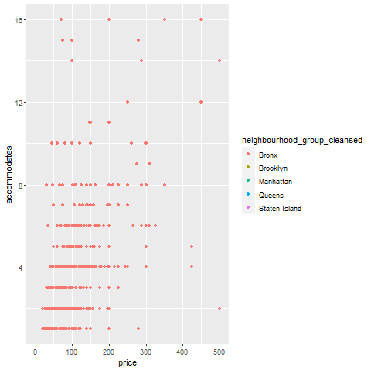
Physical Attributes:Accommodates
Accommodates: Positive relationship between price and the number of people accommodated in the unit

Slide 23
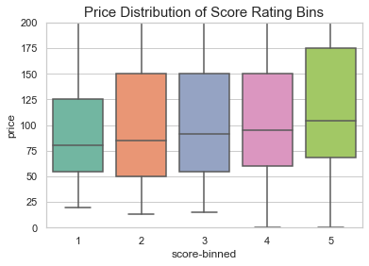
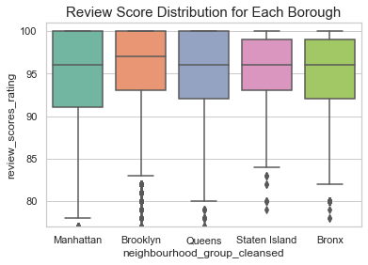
Physical Attributes:Review Scores
Review Scores:
average: 93.92, max: 100, min: 20
grouped into 5 bins
Slightly positive relationship between price and score distribution
Staten Island and the Bronx
Bin | Score Range
1 | 20-36
2 | 36-52
3 | 52-68
4 | 68-84
5 | 84-100

Slide 24
Deeper Dive
In our report we dive deeper into the neighborhoods within the boroughs
As seen on the next slide , each borough has its own profile visualizing the physical attributes’ relationship to price along with the review bins related to price
Each of the top 5 neighborhoods has a profile as well utilizing data from only the top 10 hosts of that neighborhood

Slide 25
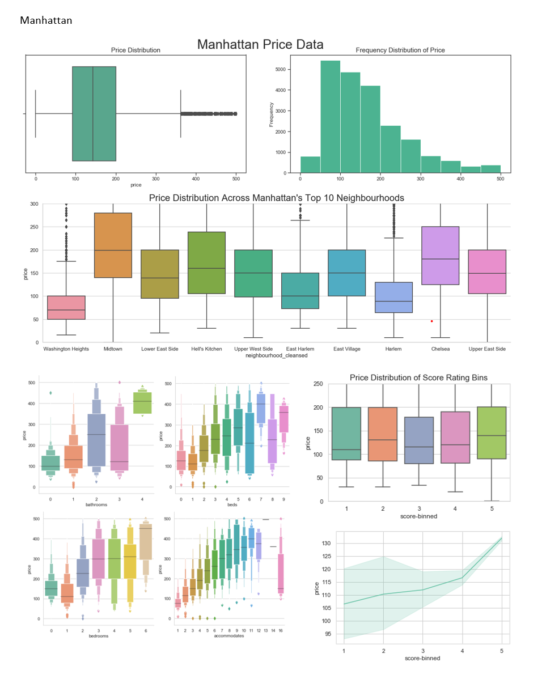
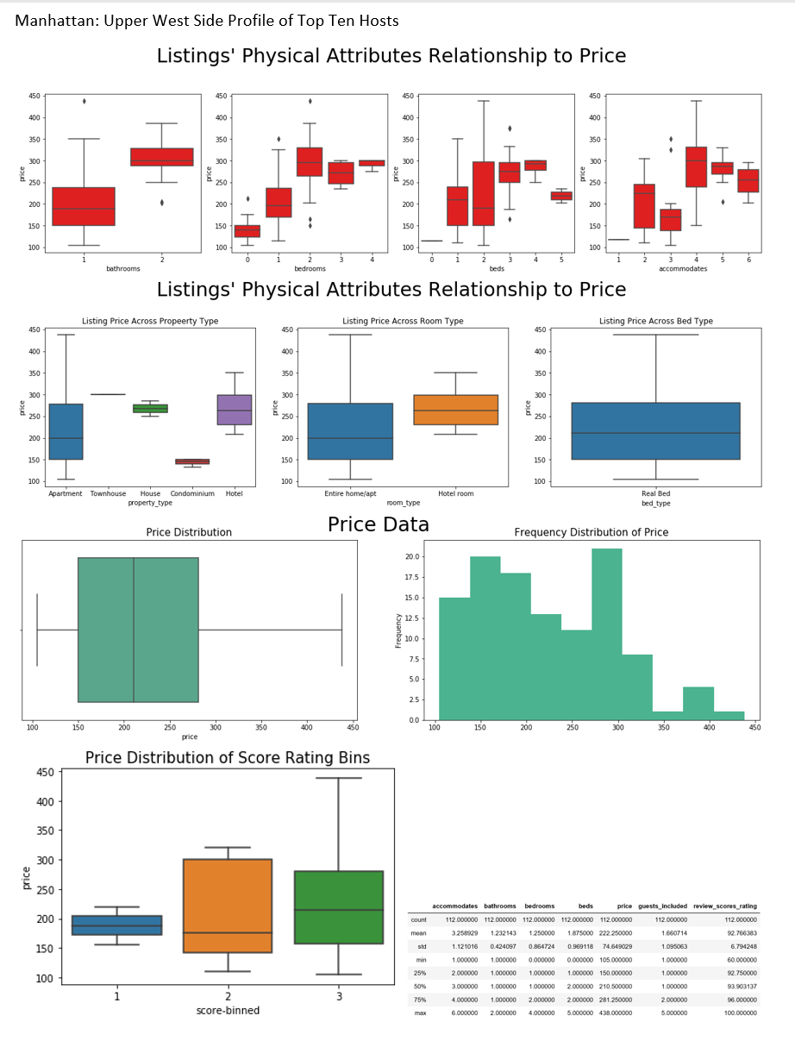

Slide 26
Conclusion
How is list price by location and physical attributes?
Number of bathrooms: positive
Numbers of beds: positive
Number of bedrooms: positive
Accommodates: positive
Room type: yes
Property type: yes
Bed type: Majority of listings are real bed, somewhat
Neighborhood and borough: yes
What impact does price have on review scores?
Across all of New York City: positive relationship between price and review scores
Inboroughs individual neighborhoods this varies: brooklyn: strong positive, manhattan slight positive, Queens and Bronx have slightly negative, and Staten Island only has scored in the top three bins, those show a positive relationship with price

Slide 27
Why are there more airbnbs in certain locations?
If we use airbnb distance from a landmark/subway stations, can we tell where people want to stay?
Rounak
Notes:
So i’ll be covering the question of why could there be more airbnbs in certain locations?
I’ll investigate if using airbnb distance from a certain landmark and subway station could help us understand where people want to stay.

Slide 28
Conditions:
Hypothesis & Objectives:
Hypothesis:
Condition 1
Within 1 Mile
Condition 2
Price less than $200
Condition 3
Available at least 6 months out of the year
More airbnbs will be widely available in areas where the greatest known landmarks are regardless of the condition we require
Condition 4
At least 10 Reviews
Condition 5
Offer an entire home or apartment
Condition 6
Minimum night stay of 3 or less
Condition 7
At least ¼ of a mile to a Subway
Notes:
So basically, our hypothesis is that more airbnbs will be available in areas where the most popular landmark is regardless of the condition or filter we put on the airbnb search.
Essentially, we assume that the more popular landmarks = More foot traffic = more airbnbs available
We end up having 7 conditions in our analysis:
First we’ll check to see how many airbnbs are within a 1 mile radius of the landmark
Then we’ll check to see how many of those airbnbs are within 1 mile and less than $200.
Then within 1 mile and available at least 6 months out of the year
Then airbnbs with 10 reviews, entire home/apartments, minimum night stays of 3 or less, and finally ¼ of a mile away from a subway station.

Slide 29
Understanding our tools:
Geopandas:
Spatial Operations:
CSV Files:
Converts our airbnb dataset into points and polygons using the longitude and latitude: - Easier to visualize our dataset using maps
Includes the creation of boundaries, inside or outside an existing polygon, offset by a certain distance
A Comma Separated Values (CSV) file is a plain text file that contains a list of data; We’ll be using: - NYC Subway Stations - NYC Neighbourhoods Boundaries
Notes:
Before I go further, I want to help the class understand 3 different things I used that we did not go into much in class -
First, I am using all the skills used in class in conjuction with geopandas, spatial operations and outside csv files.
Geopandas is similar to pandas our professor taught us in which we can convert our dataset into points and polygons using longitude and latitude. It helps us visualize our dataset if we have a csv files that correspond to the same dataset.
Second, we use spatial operations which help us create spaces and boundaries with buffers that ultimately create polygons.
Finally, our outside csv files that I will use is nyc subway stations and neighbourhoods boundary information.

Slide 30
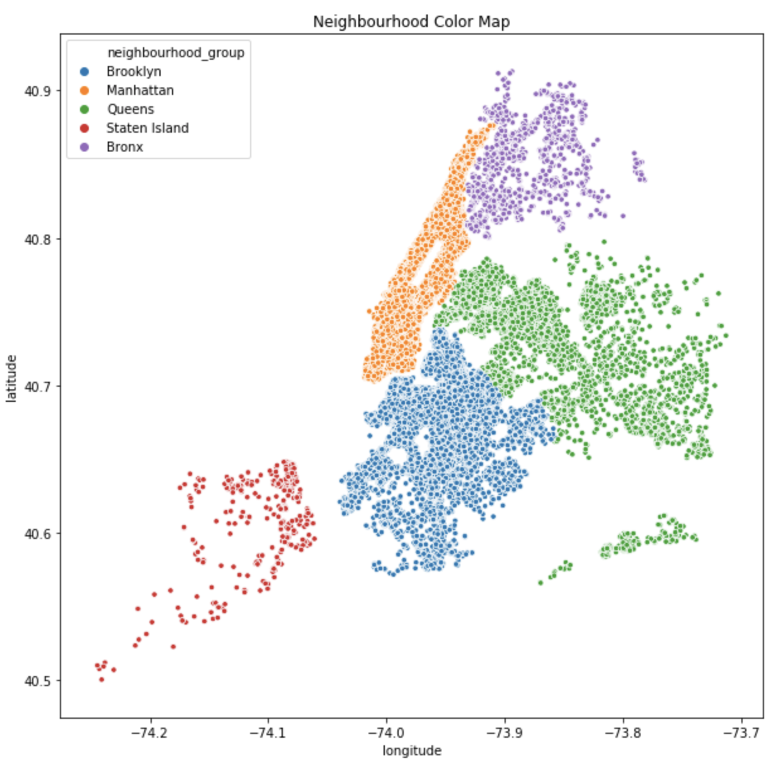
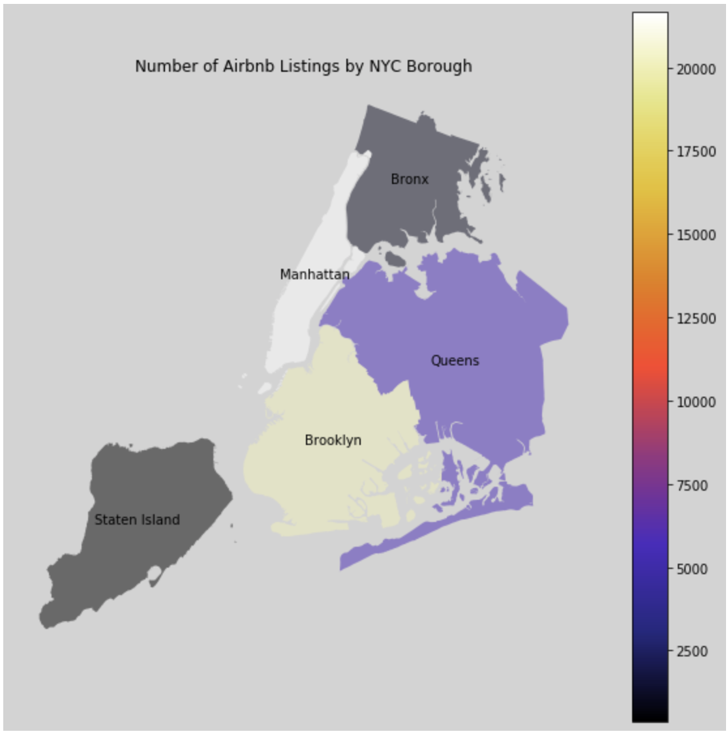
Initial Neighbourhood Group Analysis:
Seaborn Scatter Plot of the 5 boroughs
Clearly Manhattan & Brooklyn have the most number of listings
Notes:
So initially, we can use seaborn to visualize our 5 boroughs. But by using a png file, we are able to enclose it using geopandas and show which borough has the most number of listings through a heatmap

Slide 31
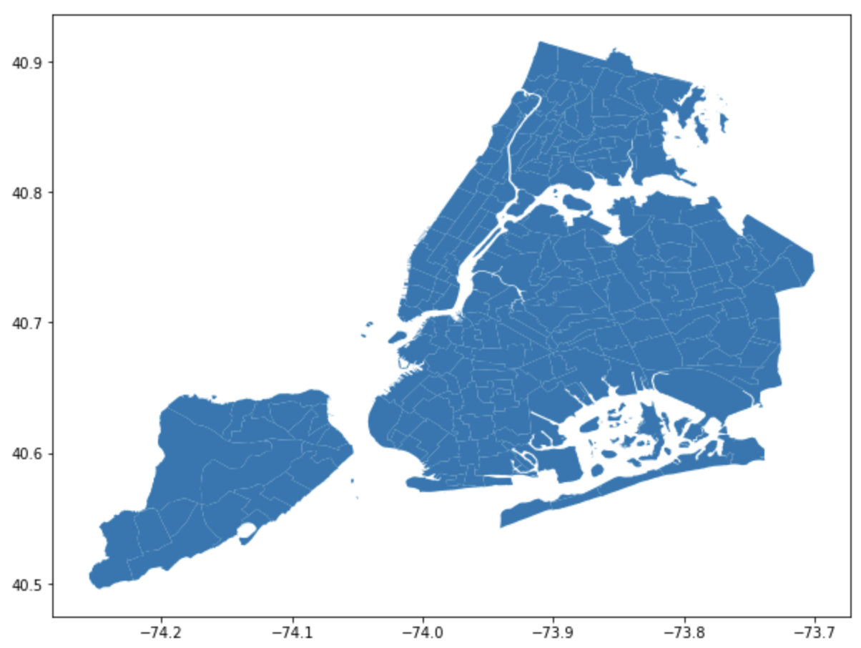
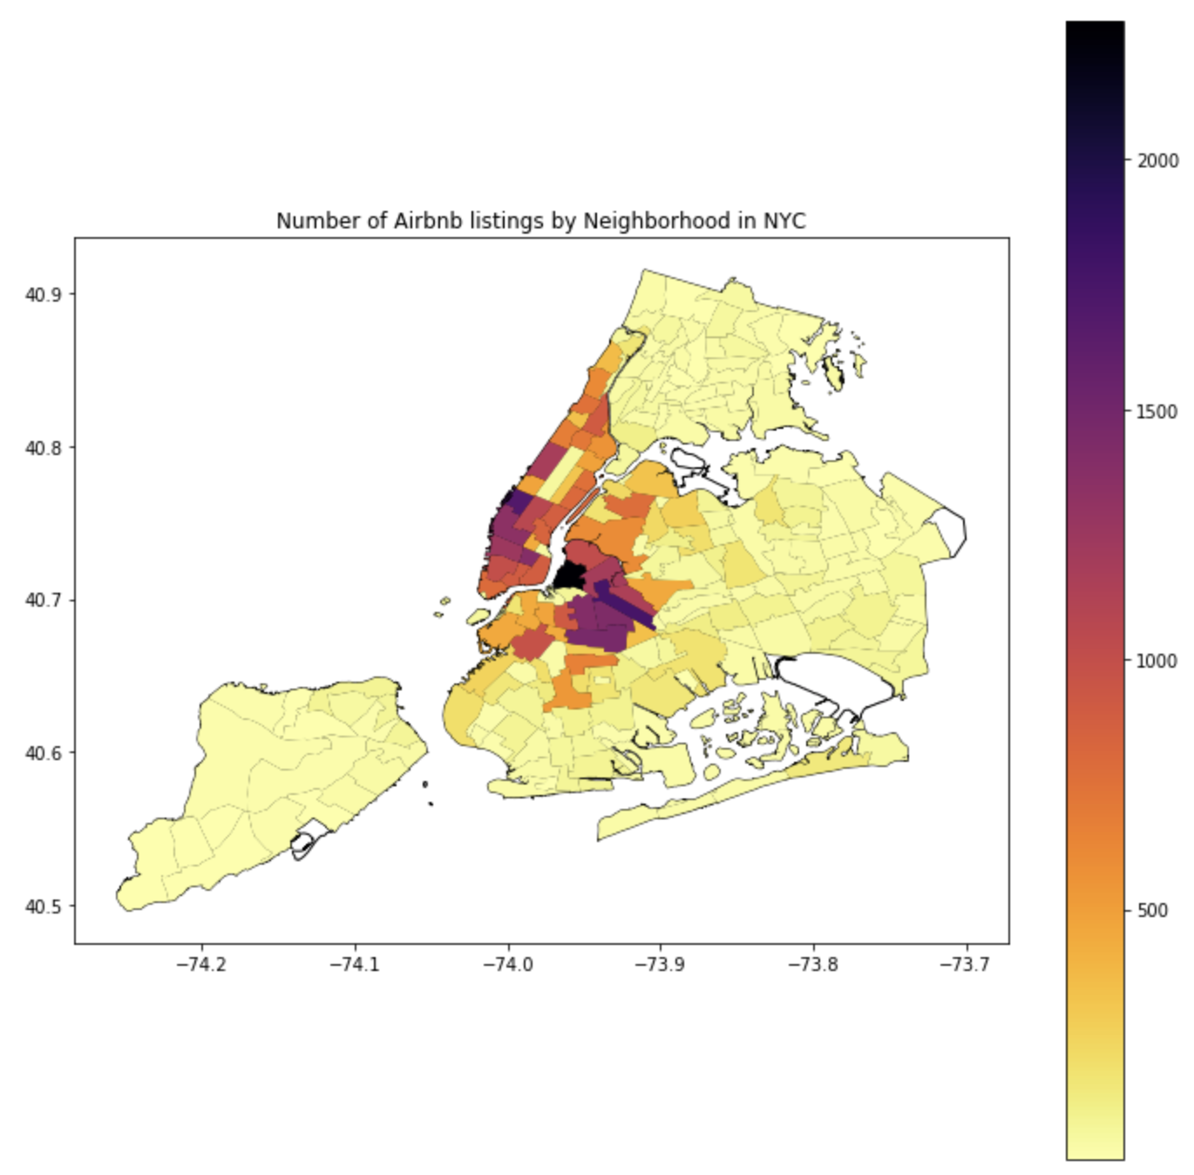
Initial Geospatial Borough Analysis:
NYC Neighbourhoods CSV File:
Heat Map by each neighbourhood:
Notes:
Now we have a NYC neighbourhood CSV file that we import and combining with our information we get a map plotted using longitude and latitude to show each approximate neighbourhood. If you look closely you can see the lines.
Finally, we take that and show the most densely populated neighbourhood in terms of number of airbnb listings in NYC in a heat map. As you can see all of manhattan, and portions of queens and brooklyn are the most populated with outskirts only having very few.

Slide 32
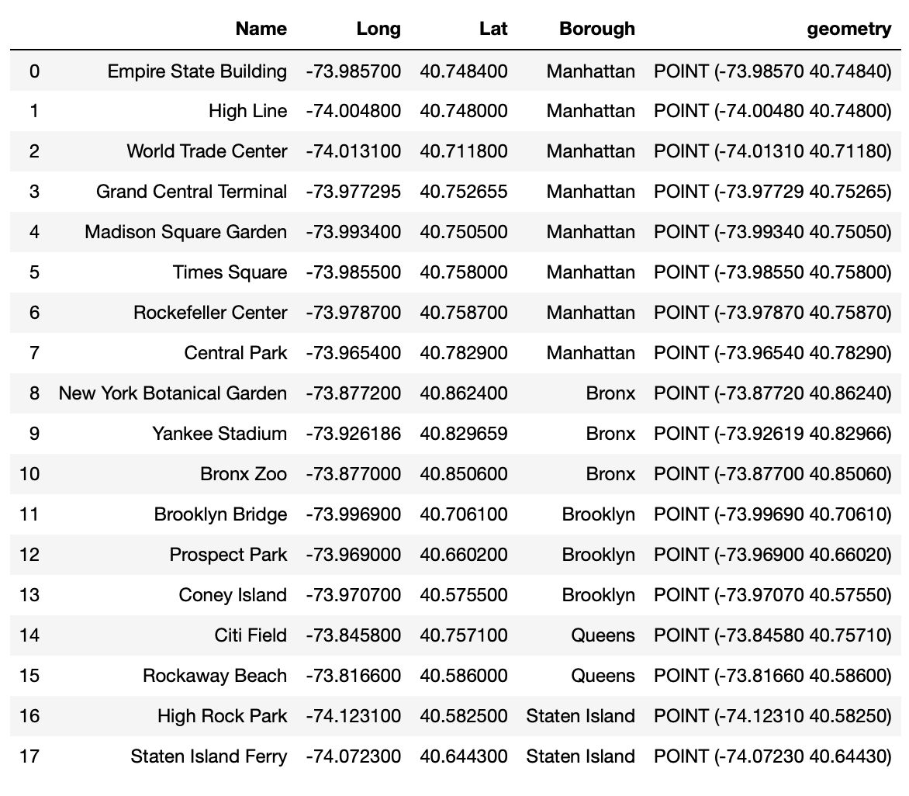
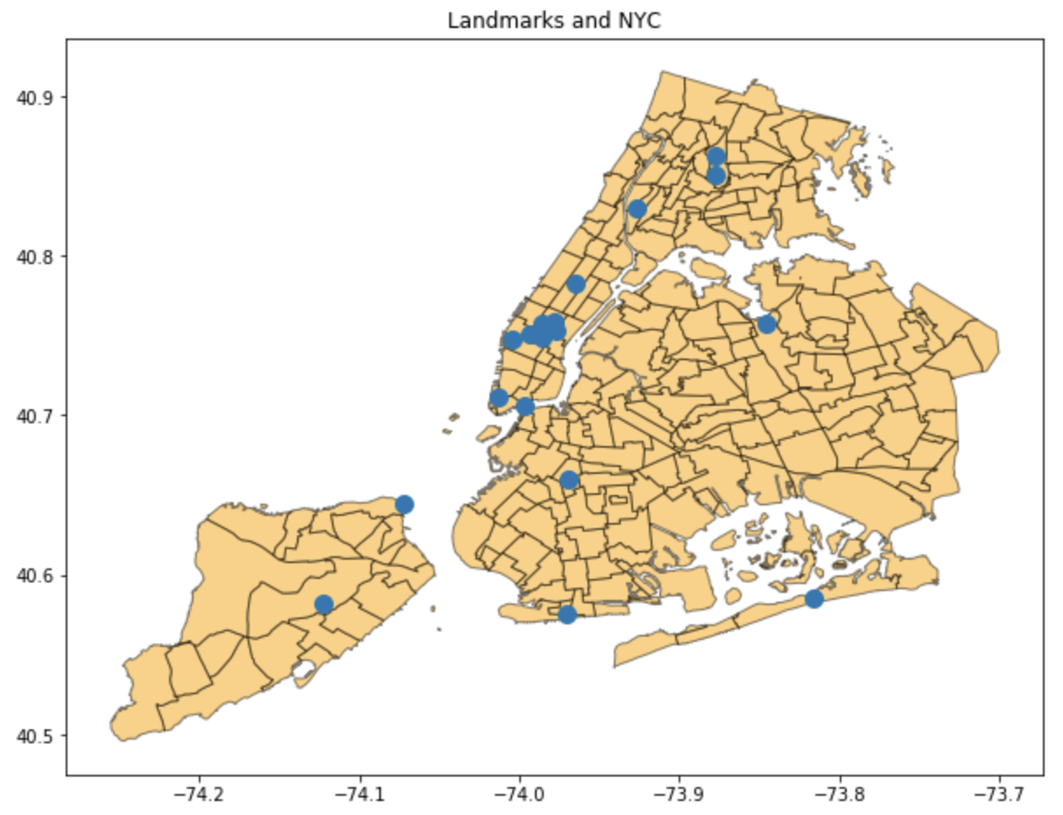
Landmarks to Analyze:
All the Landmarks:
All Landmarks Mapped:
Notes:
So for the rest of our analysis, we want to see around what landmarks are there more airbnb listings. We look at about 18 different landmarks ranging from ……….. Here you can see all the landmarks mapped. A lot of the top landmarks in NYC happen to be in Midtown Manhattan.

Slide 33
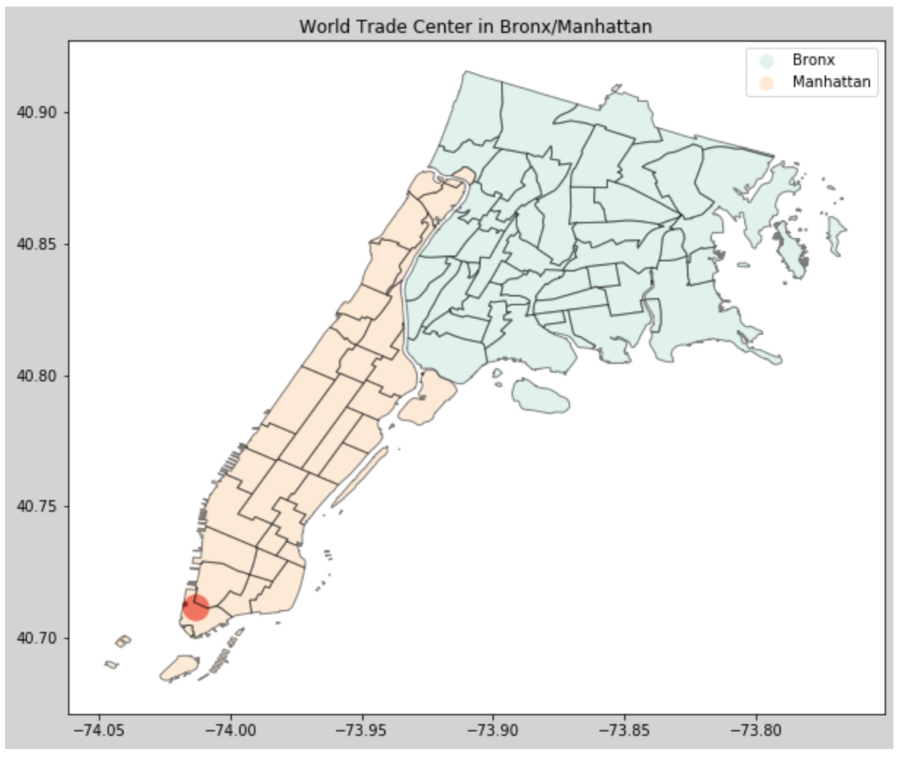
World Trade Center:
WTC with all 5 boroughs:
WTC with only Manhattan & Bronx:
Notes:
So we will only focus on the World Trade Center in this presentation but have done all the landmarks in our python analysis. Here you can see where WTC is in all the 5 boroughs and then in a map of only bronx/manhattan

Slide 34
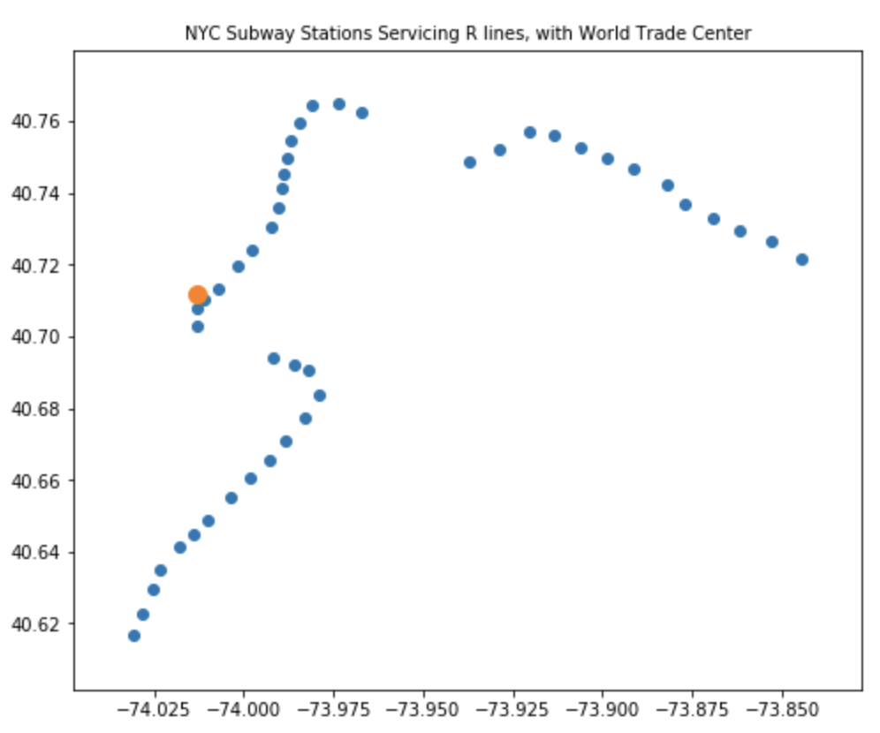
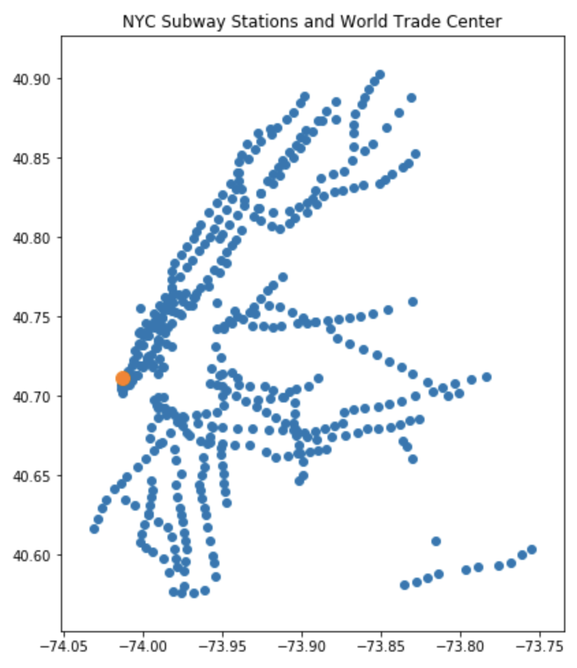
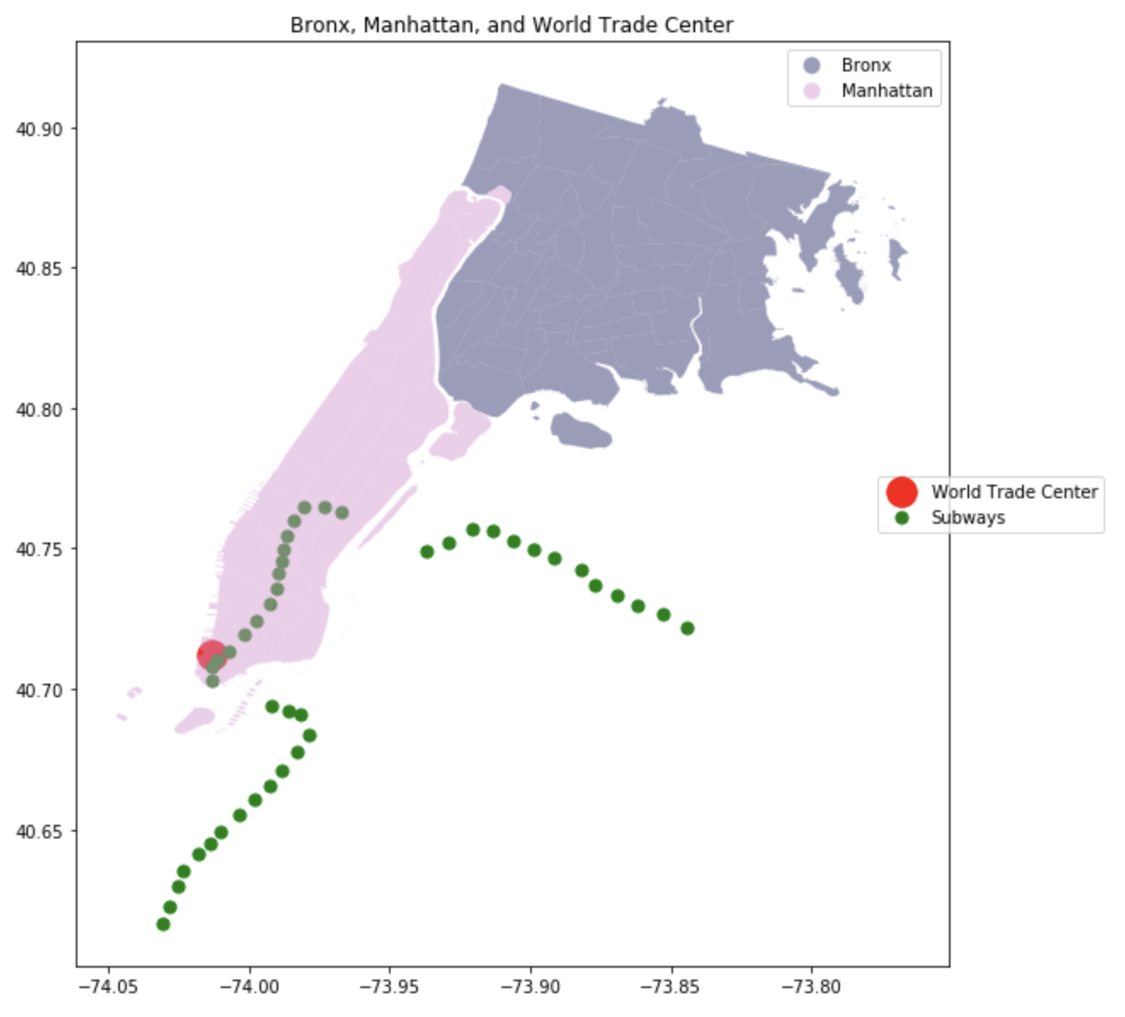
World Trade Center & Subway Stations:
WTC & All Subway Stations:
WTC & Only the R-Line Stations
Notes:
We also combine our dataset with outside subway csv file to understand what subway line is the most popular around this landmark that people would want to find an airbnb to get around NYC.
It took analyzing through google maps to get this information but we finally narrowed it down to the R-line for this landmark and each landmark has its only line.

Slide 35
World Trade Center
Without filtering each time & satisfying each condition separately:
Filtering each time & satisfying all conditions:
Notes:
Ultimately, we come out to the following information:
There are ……
but if we decided to filter each time and keep that filter to narrow our search like an actual airbnb selection customers might use on their website we would come down to ……

Slide 36
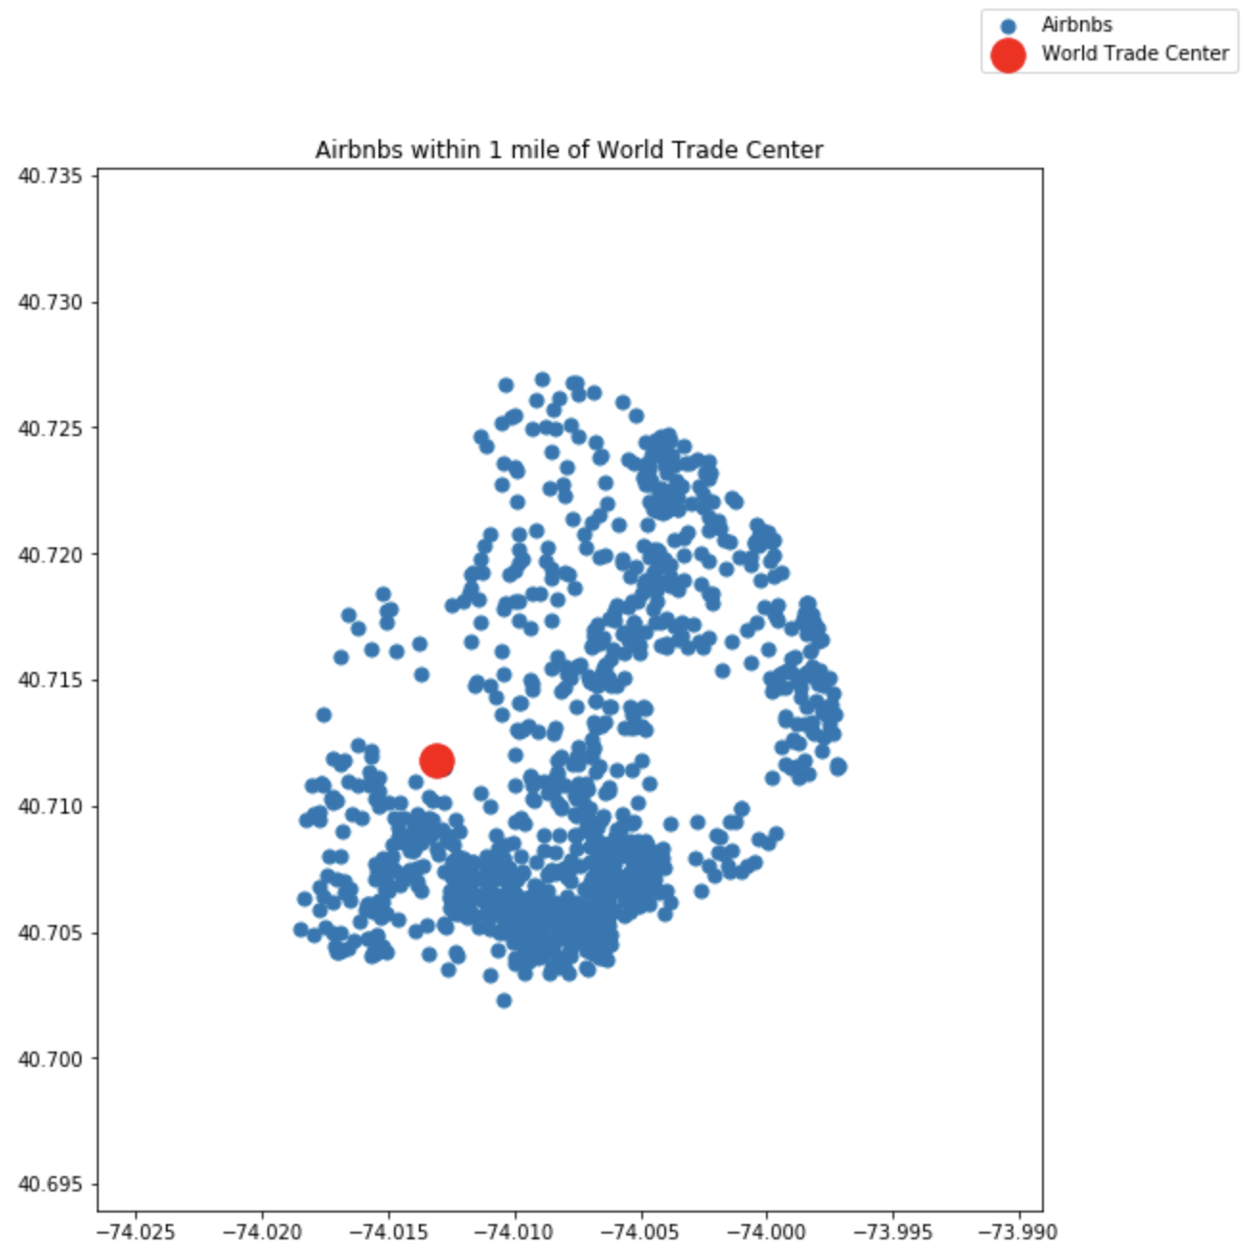
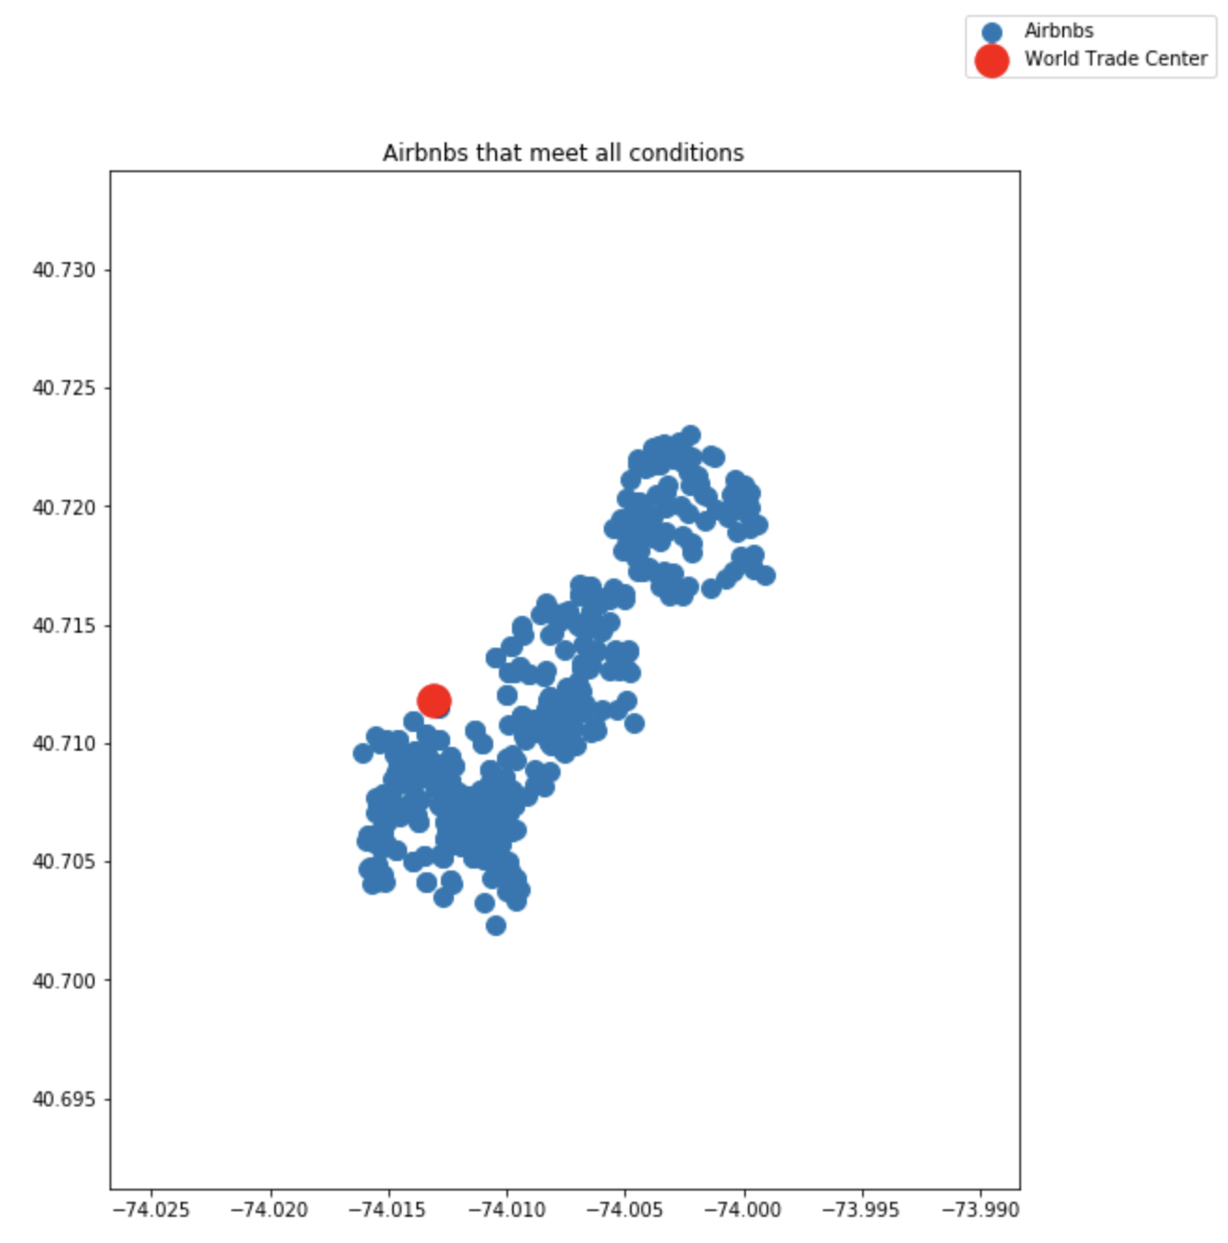
Number of Airbnbs After Our Conditions:
Airbnbs within 1 mile of WTC:
Airbnbs within 1 mile of WTC & ¼ of a mile away from a subway station of the R Line:
Notes:
Here you can see the number of airbnbs and where they are in respect to the landmark we are analyzing so WTC. On the right you can see that if we choose to look at airbnbs within 1 mile of WTC AND ¼ of a mile away from a subway station on the R line - everything is more condensed.

Slide 37
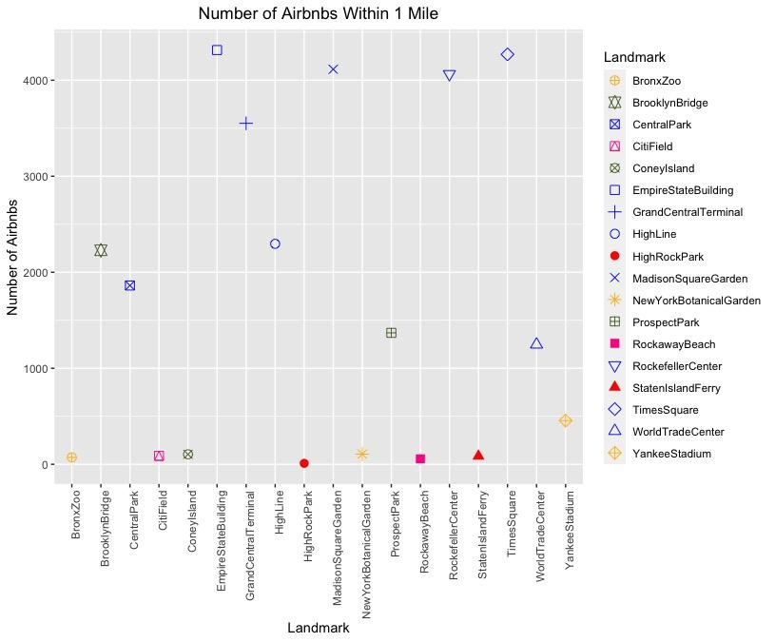
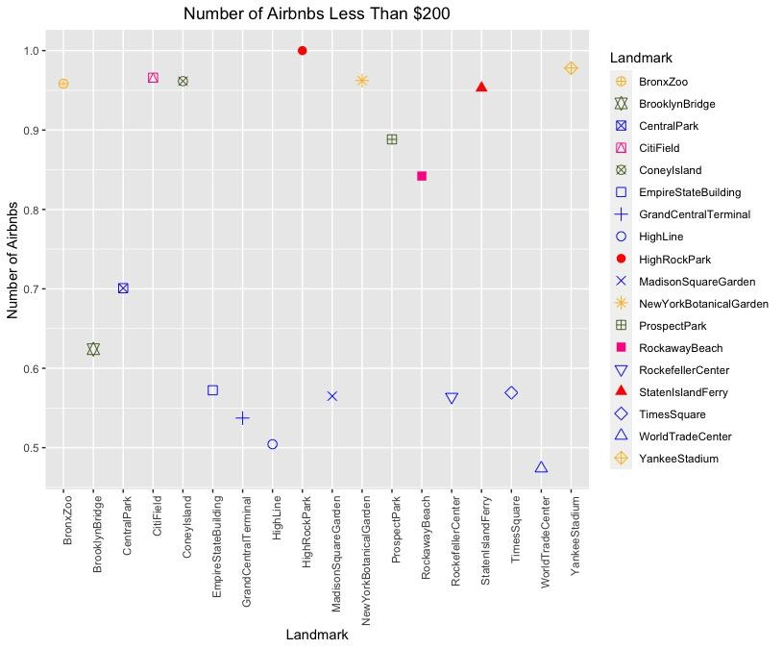
Compare Landmarks Using R:
Within 1 Mile:
Less than $200:
Notes:
Finally, let’s take a look at our R analysis. Each of our analyses organized by color - which tells us which borough the landmark is in. Blue = Manhattan, Green = Brooklyn, Yellow = Bronx, Pink = Queens, Red = Staten Island
The first graph tells us the number of airbnbs within 1 mile and clearly manhattan leads. In the next couple of graphs, we use percentage of the total within 1 mile away from the landmark. So here you can see 100% of staten islands total are less than $200. Manhattan however, seems to be the most expensive.

Slide 38
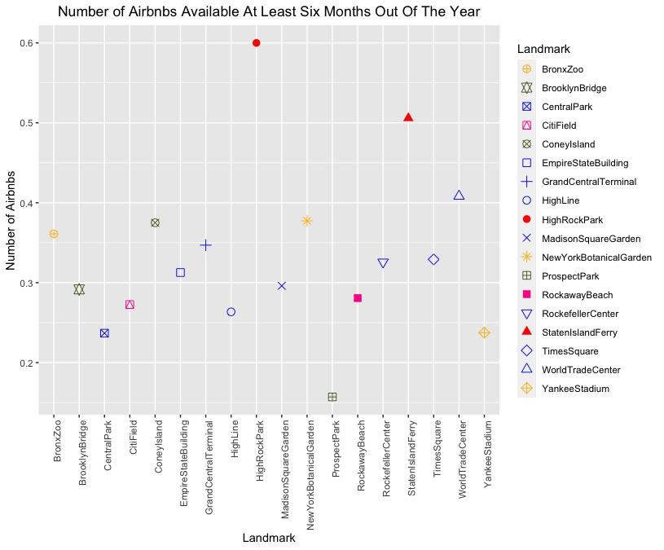
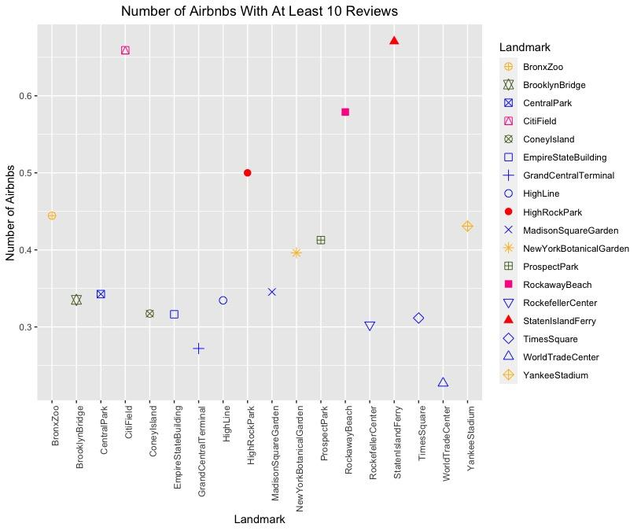
Compare Landmarks Using R:
Available at least half of the year:
At least 10 reviews:
Notes:
Here, staten island also leads in available more than half of the year but central park many are not available. Next, very few manhattan landmarks have at least 10 reviews.

Slide 39
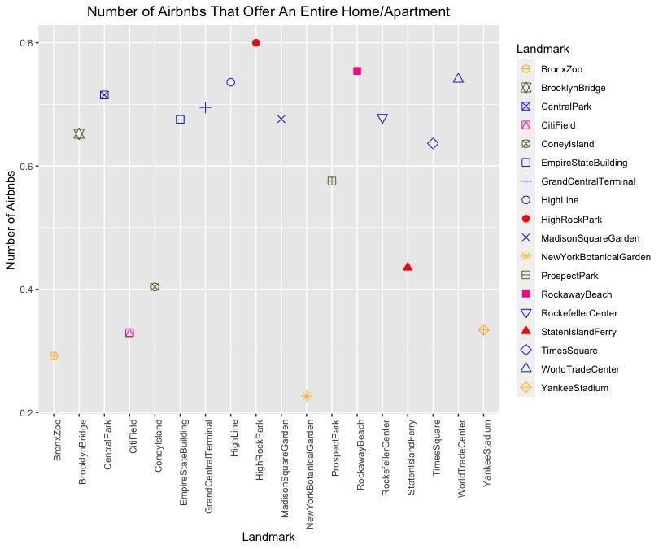
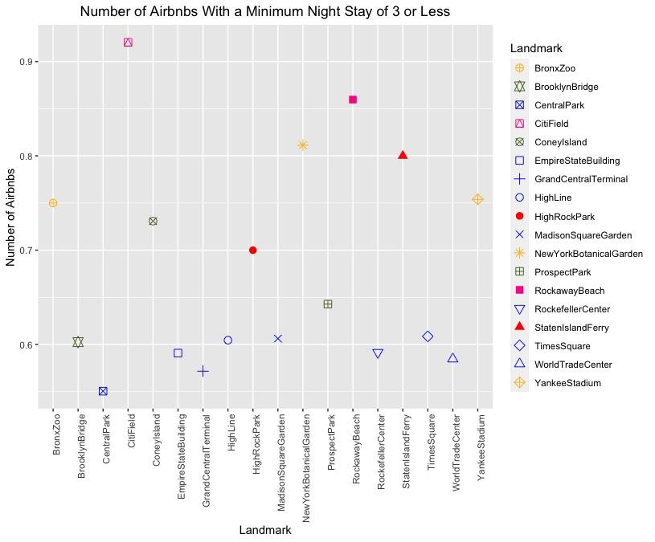
Compare Landmarks Using R:
Offer an entire home/apartment:
Minimum night stay of 3 or less:
Notes:
Here you can see most places offer an entire home/apartment while it looks like Bronx airbnbs do not. In terms of minimum of 3 or less night stay, manhattan airbnbs are also less than 50%.

Slide 40
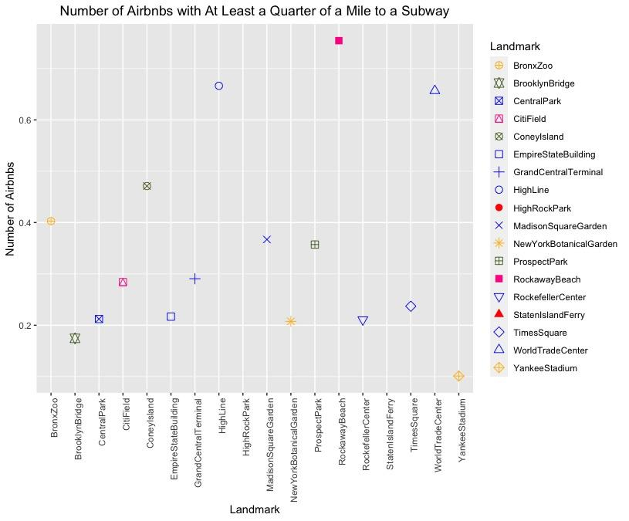
Compare Landmarks Using R:
At least ¼ of a mile to a Subway:
Now that we’ve compared each landmark & different conditions…
We will rank each landmark according to most popular in terms of all around Airbnb Status
Notes:
Last but not least, Rockaway beach has the most airbnbs that are at least a quarter of a mile to a subway
Now that we’ve compared all landmarks and conditions, we can rank each landmark to see which ones might be most popular for airbnbs.

Slide 41
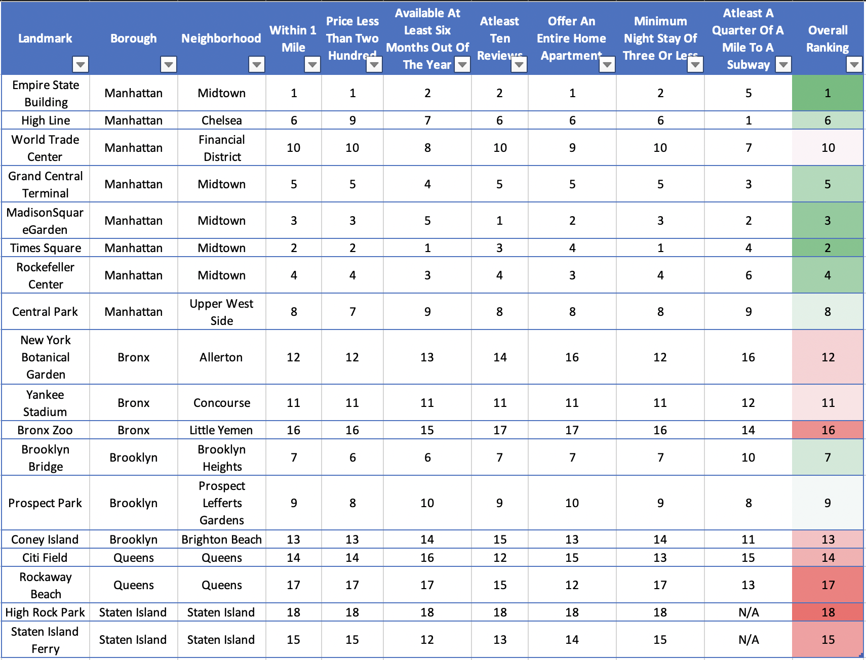
Rankings:
Empire State Building
Yankees Stadium
1
Times Square
1
New York Botanical Garden
Madison Square Garden
Bronx Zoo
3
2
3
2
#1 Manhattan
#3 Bronx
Brooklyn Bridge
Staten Island Ferry
Citi Field
1
Prospect Park
1
Rockaway Beach
1
High Rock Park
Coney Island
3
2
2
2
#2 Brooklyn
#4 Queens
#5 Staten Island
Notes:
Overall, manhattan and brooklyn are #1 and #2 respectively. In manhattan - empire state building, times square and madison square garden have the most airbnbs that fulfill our conditions within 1 mile away. For brooklyn, its brooklyn bridge, prospect park and coney island.

Slide 42
Conclusion:
Hypothesis:
As you can see, from our initial hypothesis we expect the most populated airbnb locations to remain the most popular
After our analysis:
Manhattan & Brooklyn remain on top as boroughs with most airbnbs near landmarks and subway stations
Percent of total airbnbs within 1 mile away gives us another conclusion
More airbnbs will be widely available in areas where the greatest known landmarks are regardless of the condition we require
Notes:
In conclusion, our initial hypothesis of expecting the most populated airbnb locations in terms of listing also seem to have the most popular landmarks which might be the reason why more airbnbs are listed near them. We can see manhattan and brooklyn remain on top as bouroughs with most airbnbs near landmarks and subway stations. However, if we choose to look at percent of total airbnbs within 1 mile away that will give us another conclusion.

Slide 43
What are the key predictors of price?
Can we get an approximate range for each neighborhood, room type, and other predictors?
—Dhruval

Slide 44
Methodology
Finding relationships between independent variables and the dependent variable.
Summarizing statistics for each column
Engineering features for modelling phase.

Slide 45
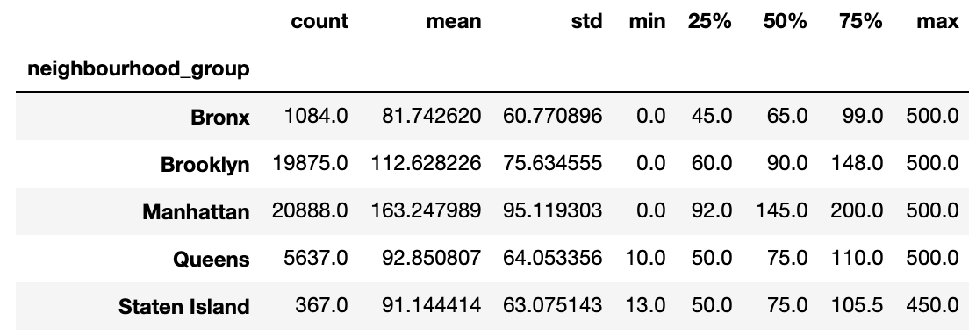
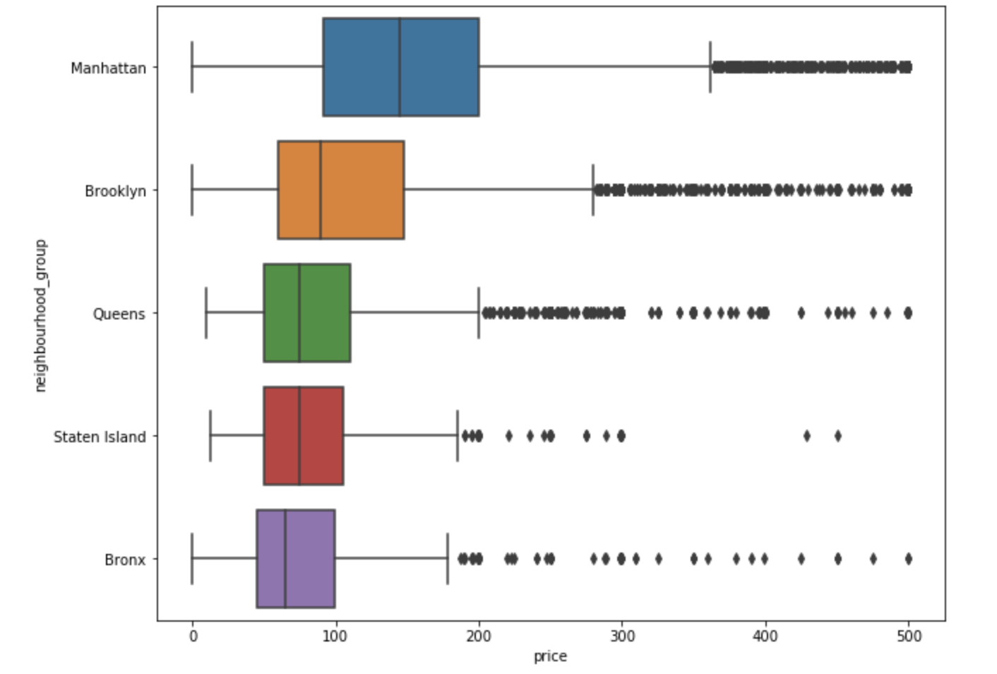
Neighbourhood group
There are 5 different neighbourhood groups in our dataset. There is considerable difference in the means for manhattan and brooklyn compared to other neighbourhood groups.
I believe an airbnb in these neighbourhood groups will be priced higher.

Slide 46
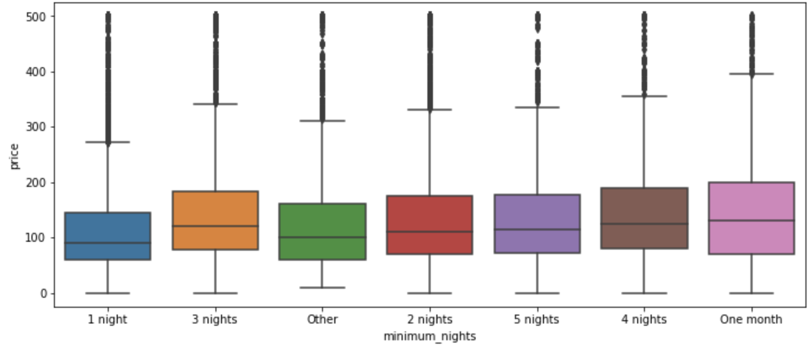
Minimum nights
Minimum nights was a numerical variable. There were some values that were frequently occuring. The variable can be converted to a categorical value and the rest can be treated as other category.
The means do not show that much difference in the box plot. One month and three nights seem to be on the higher portion of the price spectrum while 1 night tend to be lower.

Slide 47
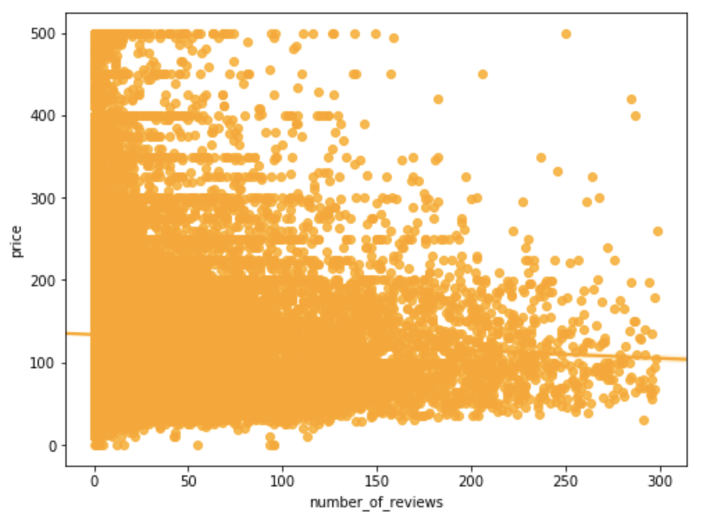
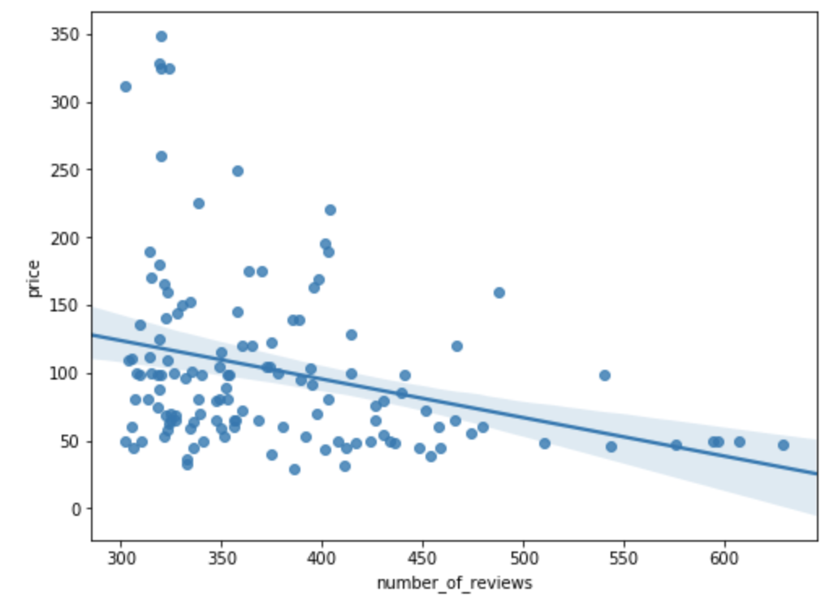
Number of Reviews
During analysis I noticed that a lot of Airbnbs didn’t have any reviews. First graph, shows the price of Airbnbs with number of reviews ranging between 0 and 300. You cannot observe much trend here. But in the second graph we can see negative trend as the number of reviews increases. That is interesting insight and can be used to create categorical variable with three category.

Slide 48
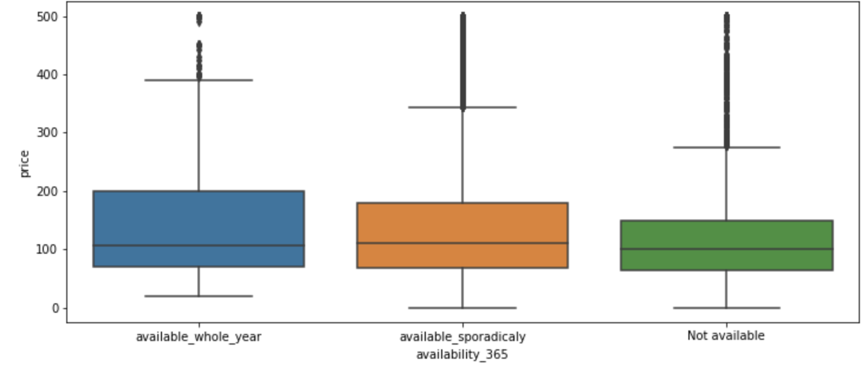
Availability 365
For this variable, the airbnb mostly takes on the value of 365 (Available throughout the year) ,0(Not available) and few values in the 0-365 range. A categorical variable can be generated from this column by splitting the values into 3 categories. We observe that not available airbnbs generally take on lower price values.

Slide 49
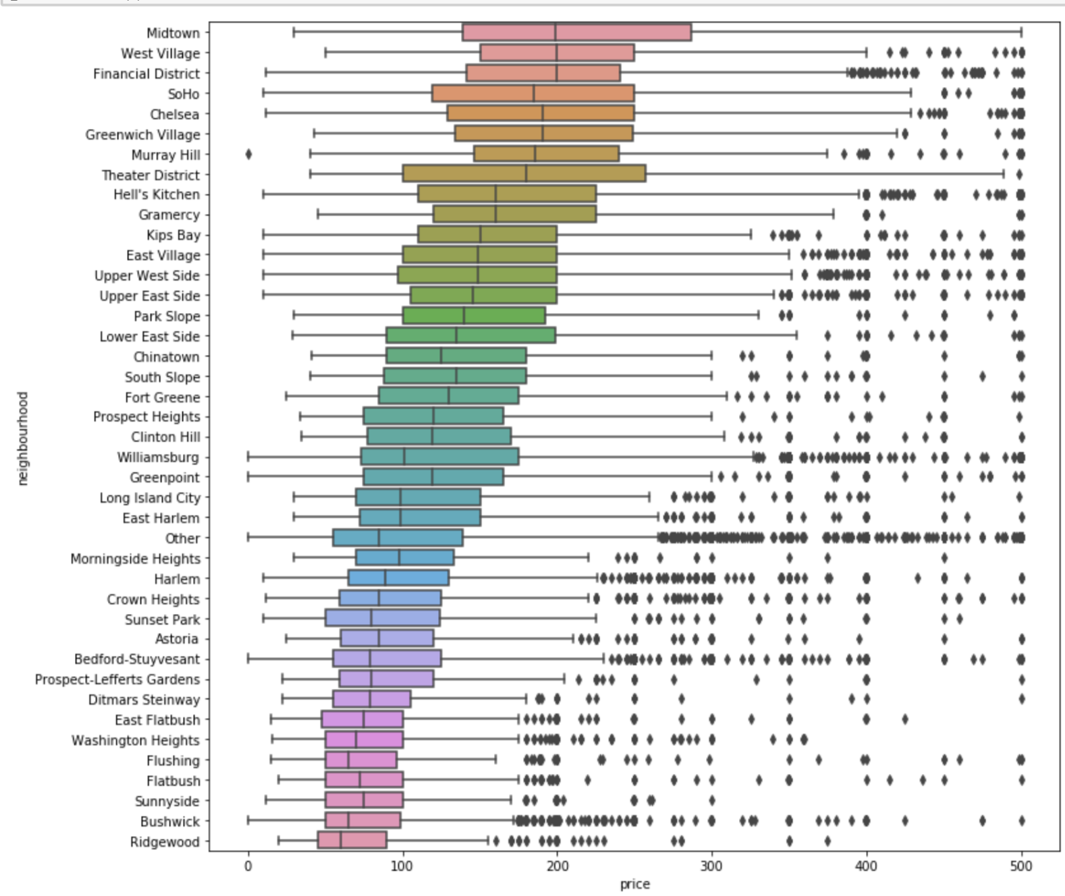
Neighborhood
Midtown, West Village & Financial District may have higher prices relatively compared to other neighbourhoods.
Sunnyside, Bushwick & Ridgewood may have lowest prices relatively compared to other neighbourhoods.
Overall this is a good variable for prediction when the top 40 neighborhoods are selected. There seems to be lot of variation in the stats among categories for this variable.

Slide 50
What kind of model can we create with this information to use as a prediction for future analytics?
What sort of predictions can we make for those hosts?
—Aakash

Slide 51
Dummy Variables for categorical variaBles
What are categorical variables?
What are dummy variables?
Dummy variables for categorical variables in the data set

Slide 52
separate x & y for training
What is splitting of data?
test_size
train_size
random_state

Slide 53
linear regression
Top 5 strong negative influencers
room_type_shared room
room_type_private room
neighborhood_washington heights
neighborhood_harlem
neighborhood_morningside heights
Top 5 strong negative influencers
Number_of_reviews_unreviewed
Neighborhood_group_Brooklyn
Neighborhood_midtown
Availability_365_available_whole_year
Neighborhood_group_manhattan

Slide 54
Random forest Regressor & SVM Regressor
What is RMSE?
RMSE for our dataset = 66.05799438835079
What is MAE?
MAE for our dataset = 43.06709592277255
SVM Regressor

Slide 55
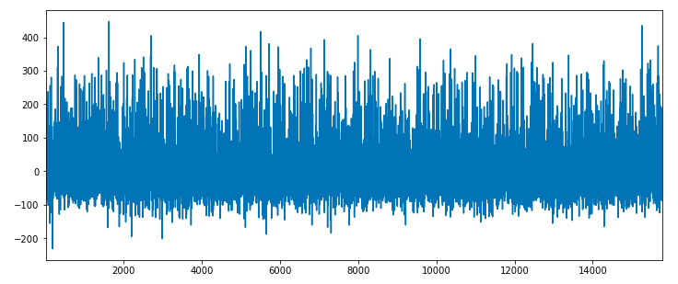
residual analysis

Slide 56
THANK YOU
QUESTIONS?

